Slide 1
Transverse Wave Motion
14th September 2020

Slide 2
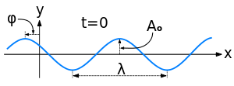
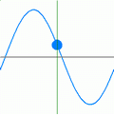
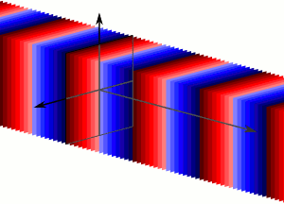
Concept of Plane wave
A typical representation of a wave propagating in space
The propagating wave causing the individual oscillators in the medium to oscillate
Overall oscillation of the oscillators with the same phase in the same plane forms the travelling plane wave.
Note : each color represents a different phase of the wave.
https://en.wikipedia.org/wiki/Plane_wave
Notes:
Plane wave : the name refers to the geometry of the wave surface.
Apart from the plane, cylindrical and spherical waves are two most common waves easily found.
The form of any wave (matter or electromagnetic) is determined by its source and described by the shape of its wavefront, i.e., the locus of points of constant phase. If a traveling wave is emitted by a planar source, then the points of constant phase form a plane surface parallel to the face of the source.
Plane waves are waves with plane wavefronts.

Slide 3
Velocities in wave motion
For a mechanical wave, the individual oscillators which make up the medium do not progress through the medium with the waves.
The three velocities in wave motion are
1. The particle velocity
2. The wave or phase velocity
3. The group velocity
For a monochromatic wave, the group velocity and the wave velocity are identical.

Slide 4
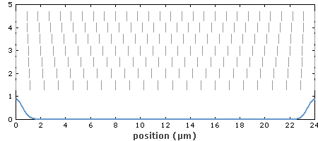
Example of the group velocity
Propagation of a light pulse in a dispersive medium. Note that the phase fronts of different frequency components propagate with different velocities, and the pulse propagates with the group velocity, which is lower than all the phase velocities;
No temporal broadening due to the propagation taking place in a nondispersive medium.
https://www.rp-photonics.com/group_velocity.html
Notes:
In the shown example, there is a reduced group velocity, but no temporal pulse broadening, since the group velocity is constant over the whole pulse spectrum, i.e., there is no group velocity dispersion.

Slide 5
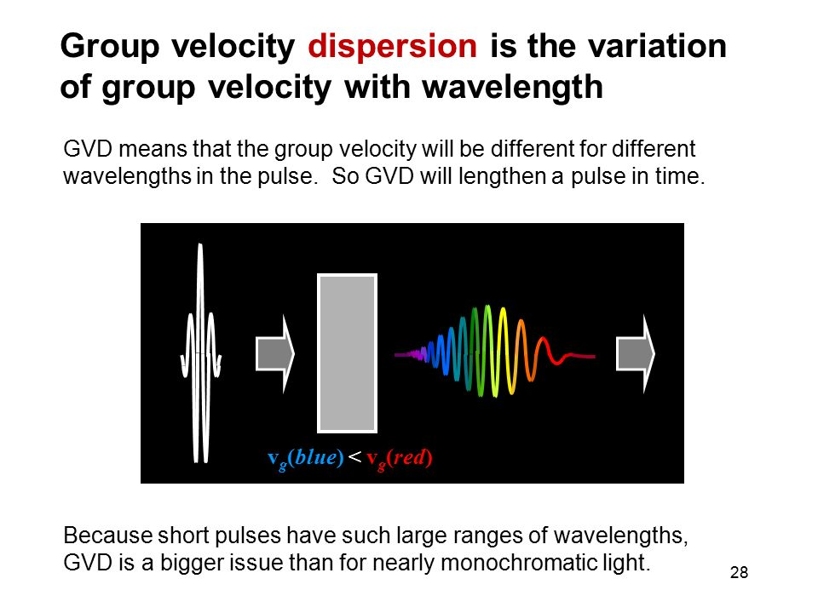
White light pulse consists of an infinite fine spectrum of frequencies and moving with a group velocity.
The wave velocity of each wavelength in the group is different.
The phenomenon is known as dispersion.
(GVD = Group Velocity Dispersion)
http://slideplayer.com/slide/10965793/

Slide 6
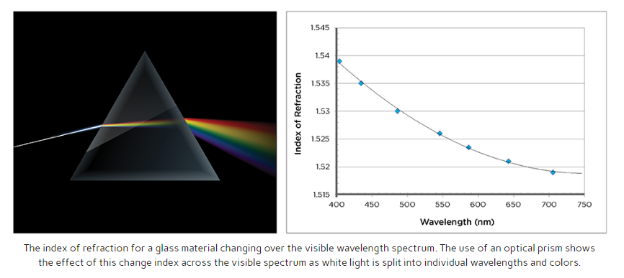
Example of dispersion
http://www.koppglass.com/blog/optical-properties-of-glass-how-light-and-glass-interact/

Slide 7
The transverse wave equation on a string
A very short section of a uniform string has a vertical displacement.
The wave equation relates the vertical displacement y to time t and position x.
Given that the linear density ρ and a constant tension T along a slightly extensible string, the wave equation is given as

Slide 8
Ideal string constraints
In order for the wave equation to apply to the waves in a string, it must meet certain constraints. For an ideal string, it is assumed that
1. The string is perfectly uniform with a constant mass per unit length and is perfectly elastic with no resistance to bending.
2. The string tension is presumed to be large enough so that gravity can be neglected.
3. Small segments of the string are presumed to move transversely in a plane perpendicular to the string, and that the displacements and slopes of segments of the string are small.
http://hyperphysics.phy-astr.gsu.edu/hbase/Waves/waveq.html#c2

Slide 9
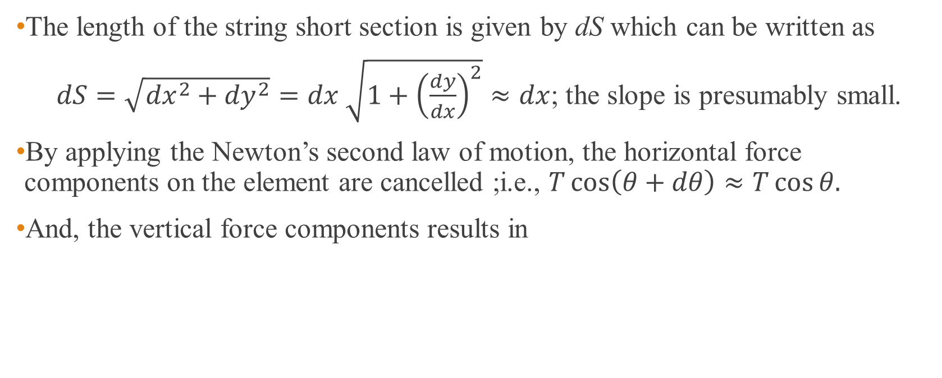
How to obtain the wave equation
The length of the string short section is given by dS which can be written as
$dS=\sqrt{{dx}^{2}+{dy}^{2}}=dx$ $\sqrt{1+{\left(\frac{dy}{dx}\right)}^{2}}≈dx$; the slope is presumably small.
By applying the Newton’s second law of motion, the horizontal force components on the element are cancelled ;i.e., $T\cos\left(θ+dθ\right)≈T\cos{θ.}$
And, the vertical force components results in
Notes:
Dx = dxcosθ and because θ→0, ∴dx ≈ds

Slide 10
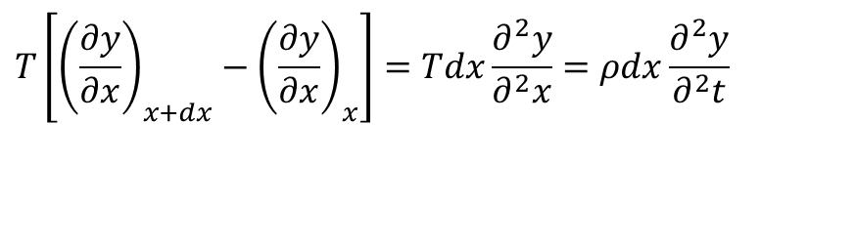
The wave equation of a wave on a string
According to the definition of the partial derivative, we have
Finally, the wave equation of a string is found to be
$$T\left[{\left(\frac{∂y}{∂x}\right)}_{x+dx}−{\left(\frac{∂y}{∂x}\right)}_{x}\right]=Tdx\frac{∂^{2}y}{∂^{2}x}=ρdx\frac{∂^{2}y}{∂^{2}t}$$
; c is the wave velocity of the wave on the string.
Notes:
Dx = dxcosθ and because θ→0, ∴dx ≈ds

Slide 11
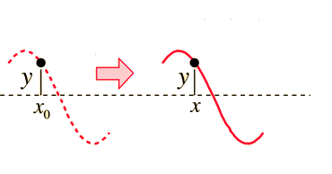
Solution of the wave equation : travelling wave
The solution of the wave equation is a function of the variables x and t.
The right and left travelling (or progressive) waves can be written as
Note :
Initially, a wave function is given as y = asin(ωt₀ – kx₀).
At a later time t (>t₀), the wave function becomes y = asin(ωt - kx).
∴ ωt₀ – kx₀ = ωt – kx and this leads to x > x₀ . This suggests the right moving waveform.
t
t₀
http://hyperphysics.phy-astr.gsu.edu/hbase/Waves/wavsol.html#c3

Slide 12
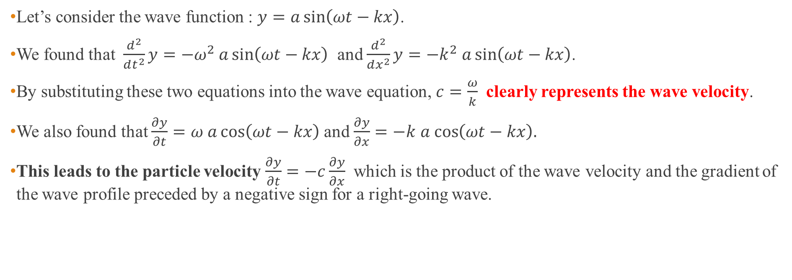
The wave velocity and the particle velocity
Let’s consider the wave function : $y=a\sin\left(ωt−kx\right)$.
We found that $\frac{d^{2}}{dt^{2}}y=−ω^{2}$ $a\sin\left(ωt−kx\right)$ and $\frac{d^{2}}{dx^{2}}y=−k^{2}$ $a\sin\left(ωt−kx\right)$.
By substituting these two equations into the wave equation, $c=\frac{ω}{k}$ clearly represents the wave velocity.
We also found that $\frac{∂y}{∂t}=ω$ $a\cos\left(ωt−kx\right)$ and $\frac{∂y}{∂x}=−k$ $a$ $\cos\left(ωt−kx\right).$
This leads to the particle velocity $\frac{∂y}{∂t}=−c\frac{∂y}{∂x}$ which is the product of the wave velocity and the gradient of the wave profile preceded by a negative sign for a right-going wave.

Slide 13
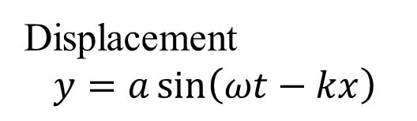
Displacement
$$y=a\sin\left(ωt−kx\right)$$
Particle velocity
The magnitude and direction of the particle velocity $\frac{∂y}{∂t}=−c\frac{∂y}{∂x}$at any point x is shown by an arrow in the right-going sine wave above

Slide 14
Characteristic impedance
Any medium through which waves propagate will present an impedance to those waves.
The impedance to progressive transverse waves is defined as the transverse impedance,
The velocity v here is the particle velocity NOT the wave velocity.
For a harmonic force, the ratio of force to velocity describes how hard to move the object – this depends both on how much inertia (e.g. linear density) the object has and on how strong the restoring force (e.g. tension) is.
The impedance, represented a medium characteristic, can be either real (for lossless case) or complex (for loss case).
Notes:
For a harmonic force, the ratio of force to velocity tells you how hard it is to move the object – this depends both on how much inertia the object has and on how strong the restoring force is

Slide 15
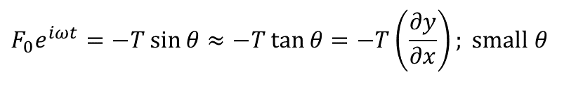
Characteristic impedance of a string
The string as a forced oscillator with a vertical force F₀exp(iωt) driving at one end.
For a minimum value of the particle velocity, the constant tension T in the string is balanced by the force at the end of the string.
This gives
$$F_{0}e^{iωt}=−T\sin{θ}≈−T\tan{θ}=−T\left(\frac{∂y}{∂x}\right); \text{small} θ$$
Notes:
Since the velocity c is determined by the inertia and the elasticity, the impedance is also governed by these properties.
The concept in this slide is the particle velocity is considered to be constant therefore the summation of force in the transverse direction is zero.
This constant velocity is thought to be the minimum velcoty for the particle in the medium. If the unbalanced force is considered the particle will move with
an acceleration and the velocity is getting increasing.

Slide 16
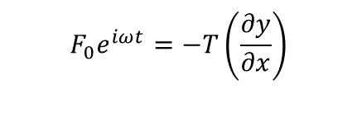
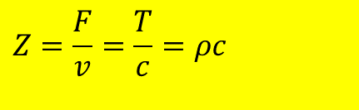
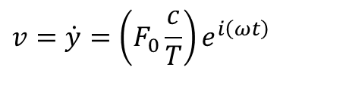


Characteristic impedance of a string (cont.)
$$y=Ae^{i\left(ωt−kx\right)}$$
If the displacement of the progressive waves is given as
The minimum velocity of the string element is obtained from
Therefore, the displacement at x = 0 is
The velocity is found to be
This leads to an alternative representation of the transverse string characteristic impedance as the ratio of the tension to the wave velocity
$$F_{0}e^{iωt}=−T\left(\frac{∂y}{∂x}\right)$$
$$y=\left(\frac{F_{0}}{iω}\frac{c}{T}\right)e^{i\left(ωt\right)}$$
$$v=\dot{y}=\left(F_{0}\frac{c}{T}\right)e^{i\left(ωt\right)}$$
$$Z=\frac{F}{v}=\frac{T}{c}=ρc$$
Notes:
Since the velocity c is determined by the inertia and the elasticity, the impedance is also governed by these properties.
The concept in this slide is the particle velocity is considered to be constant therefore the summation of force in the transverse direction is zero.
This constant velocity is thought to be the minimum velcoty for the particle in the medium. If the unbalanced force is considered the particle will move with
an acceleration and the velocity is getting increasing.

Slide 17
Reflection and transmission of wave on a string at a boundary
Waves on a string impedance ρ₁c₁ reflected and transmitted at the boundary x = 0 where the string changes to impedance ρ₂c₂
ρ₂c₂
ρ₁c₁
Boundary conditions at x = 0 :
1. geometrical condition : displacement is the same immediately to the left and right at x = 0 for all time (a continuity of the string)
2. dynamical condition : a continuity of the transverse force T(∂y∂/x) at x = 0, and therefore a continuous slope.

Slide 18
Incident, reflected and transmitted waves
This suggests that at the boundary the incident wave is partly transmitted and partly reflected due to different impedances of the media.
Notes:
Yi = A1exp(wt-k1x)
Yr = B1exp(wt + k1x)
Yt = A2exp(wt – k2x)

Slide 19
Determination of the reflection and transmission amplitude coefficients
According to the boundary conditions (at x =0 for all t)
This condition suggests that there is a continuity of the displacement.
This condition suggests that the transverse forces have to be equal so as to prevent an infinite acceleration of an infinitesimal segment of string at the interface.
Notes:
Bc1 : continuity of the displacement
Bc2 : continuity of the transverse force

Slide 20
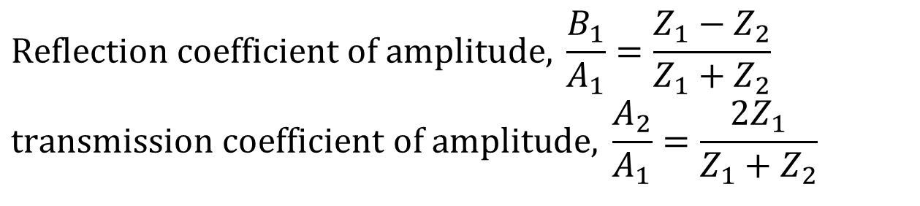
Reflection and transmission coefficients
$$\text{Reflection} \text{coefficient} \text{of} \text{amplitude}\text{, }\frac{B_{1}}{A_{1}}=\frac{Z_{1}−Z_{2}}{Z_{1}+Z_{2}} \\ \text{transmission} \text{coefficient} \text{of} \text{amplitude}\text{, }\frac{A_{2}}{A_{1}}=\frac{2Z_{1}}{Z_{1}+Z_{2}}$$
Note : these coefficients are independent of ω and hold for waves of all frequencies.
Notes:
What does it mean if Z₂ = ∞? This is a fixed end to the string because no transmitted wave exists. This gives B1/A1 = -1, so that the incident waves is completely reflected with a phase change of pi (phase reversal). And A2/A1 is zero meaning no transmission!
What does it mean if Z₂ = 0? This is a free end of the string, then B1/A1 = 1 and A2/A1 = 2. This explains the flick at the end of a whip or free ended string when a wave reaches it. The amplitude obtained in this case is observed at the boundary , eg. A2 = 2A1. Amplitude observed at other positions is still A1.
Because the string at the far end is loosely fixed. Of course no actual transmission of wave, the double amplitude is from the combination the incident amplitude and the reflected amplitude.

Slide 21
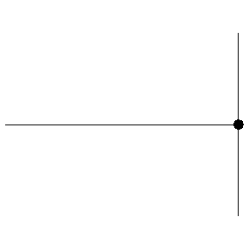
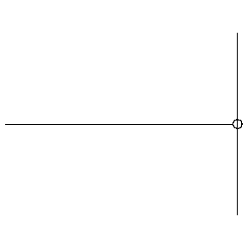
Reflections of string at fixed end (Z = ∞) and at free end (Z = 0)
At a fixed (hard) boundary, the displacement remains zero and the reflected wave changes its polarity (undergoes a 180º phase change)
At a free (soft) boundary, the restoring force is zero and the reflected wave has the same polarity (no phase change) as the incident wave
https://www.acs.psu.edu/drussell/demos/reflect/reflect.html
Notes:
What does it mean if Z₂ = ∞? This is a fixed end to the string because no transmitted wave exists. This gives B1/A1 = -1, so that the incident waves is completely reflected with a phase change of pi (phase reversal). And A2/A1 is zero meaning no transmission!
What does it mean if Z₂ = 0? This is a free end of the string, then B1/A1 = 1 and A2/A1 = 2. This explains the flick at the end of a whip or free ended string when a wave reaches it. The amplitude obtained in this case is observed at the boundary , eg. A2 = 2A1. Amplitude observed at other positions is still A1.
Because the string at the far end is loosely fixed. Of course no actual transmission of wave, the double amplitude is from the combination the incident amplitude and the reflected amplitude.

Slide 22
Example 1
A triangular shaped pulse of length l is reflected at the fixed end of the string on which it travels (Z₂ = ∞). Sketch the shape of the pulse after a length (a) l/4 (b) l/2
(c) 3l/4 and (d) l of the pulse has been reflected.

Slide 23
How to obtain a reflected pulse
Phase reversal part of the reflected wave
Notes:
How to find the phase reversal part of the reflected wave
Find the mirror image of the transmitted part around x axis
Find the mirror image of the transmitted part in 1 around y axis
You will end up with the phase reversal part of the reflected wave

Slide 24
Solution

Slide 25
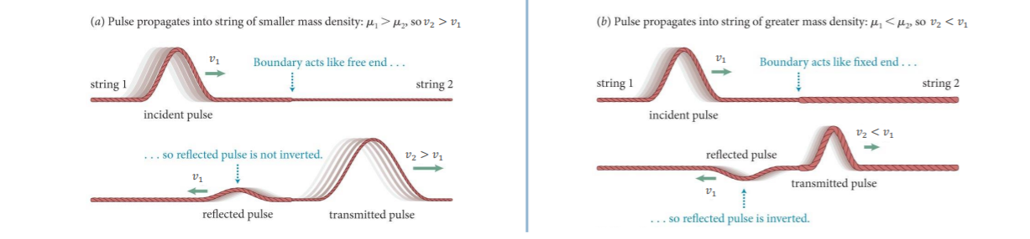
An incident wave travelling from a high density (low wave speed) region towards a low density (high wave speed) region. | An incident wave travelling from a low density (high wave speed) region towards a high density (low wave speed) region.
How do the polarities of the reflected and transmitted waves compare to the polarity of the incident wave? | How do the polarities of the reflected and transmitted waves compare to the polarity of the incident wave?
file:///C:/Users/racha/Downloads/P2018_19_Q1_Phys116_L09_Standing_waves_on_a_string.pdf
Notes:
Something wrong with 2nd animation : the amplitude of the transmitted wave is greater than the amplitude of the incident wave! How comes?

Slide 26
Example 2 : triangle wave
Consider the waveform shown below heading towards a boundary between two strings.
Let string 1 have a mass per unit length of ρ₁ = 0.1 kg/m.
Let string 2 have a mass per unit length of ρ₂ = 0.2 kg/m.
Let the tension of the string be T = 20 N.
a) Find the wave speed in each string.
b) Find the impedance of each string.
c) Find the shape of the reflected and transmitted waves and sketch them just after the incident wave completely passed the boundary.
h
String 1
String 2
w
https://www.yumpu.com/en/document/read/16791508/chapter-7-wave-equations-and-impedance-transverse-waves-in-a-

Slide 27
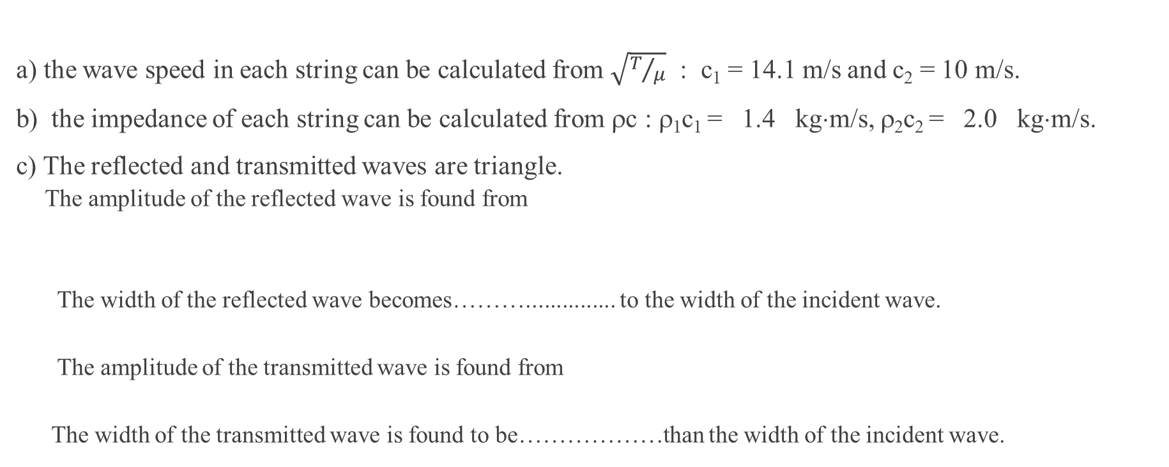
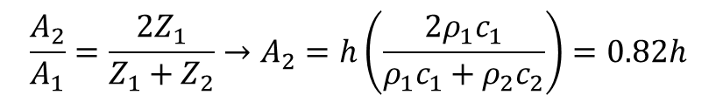
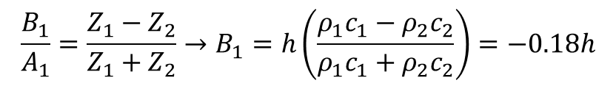
Solution
a) the wave speed in each string can be calculated from $\sqrt{T/μ}$ : c₁ = 14.1 m/s and c₂ = 10 m/s.
b) the impedance of each string can be calculated from ρc : ρ₁c₁ = 1.4 kg⋅m/s, ρ₂c₂ = 2.0 kg⋅m/s.
c) The reflected and transmitted waves are triangle.
  The amplitude of the reflected wave is found from
  The width of the reflected wave becomes………............... to the width of the incident wave.
  The amplitude of the transmitted wave is found from
  The width of the transmitted wave is found to be………………than the width of the incident wave.
$$\frac{B_{1}}{A_{1}}=\frac{Z_{1}−Z_{2}}{Z_{1}+Z_{2}}→B_{1}=h\left(\frac{ρ_{1}c_{1}−ρ_{2}c_{2}}{ρ_{1}c_{1}+ρ_{2}c_{2}}\right)=−0.18h$$
equal
$$\frac{A_{2}}{A_{1}}=\frac{2Z_{1}}{Z_{1}+Z_{2}}→A_{2}=h\left(\frac{{2ρ}_{1}c_{1}}{ρ_{1}c_{1}+ρ_{2}c_{2}}\right)=0.82h$$
narrower
https://www.yumpu.com/en/document/read/16791508/chapter-7-wave-equations-and-impedance-transverse-waves-in-a-
Notes:
the width of the reflected wave :because the speed of reflected wave and the incident wave are equal.
The width of the transmitted wave : given that Δt = w/c₁ is a time taken for the incident to pass the boundary where w is the width of the incident wave.
The distance that the transmitted wave has to cover is given by w’ = Δtc₂. By substituting Δt, the width of the transmitted wave is w’= w(c₂/c₁).

Slide 28
Reflection and transmission of energy
Now, let’s consider what happens to the energy flow in a wave when it meets a boundary between two media of different impedance values.
Generally, the energy flow or the rate at which energy is being carried along a unit length, mass ρ, of the string as a simple harmonic oscillator of maximum amplitude A with travelling wave velocity of c is
This can be shown that the energy arriving at the boundary x = 0 is equal to the energy leaving the boundary. In other words, the energy is conserved.

Slide 29
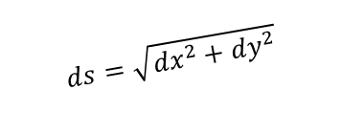
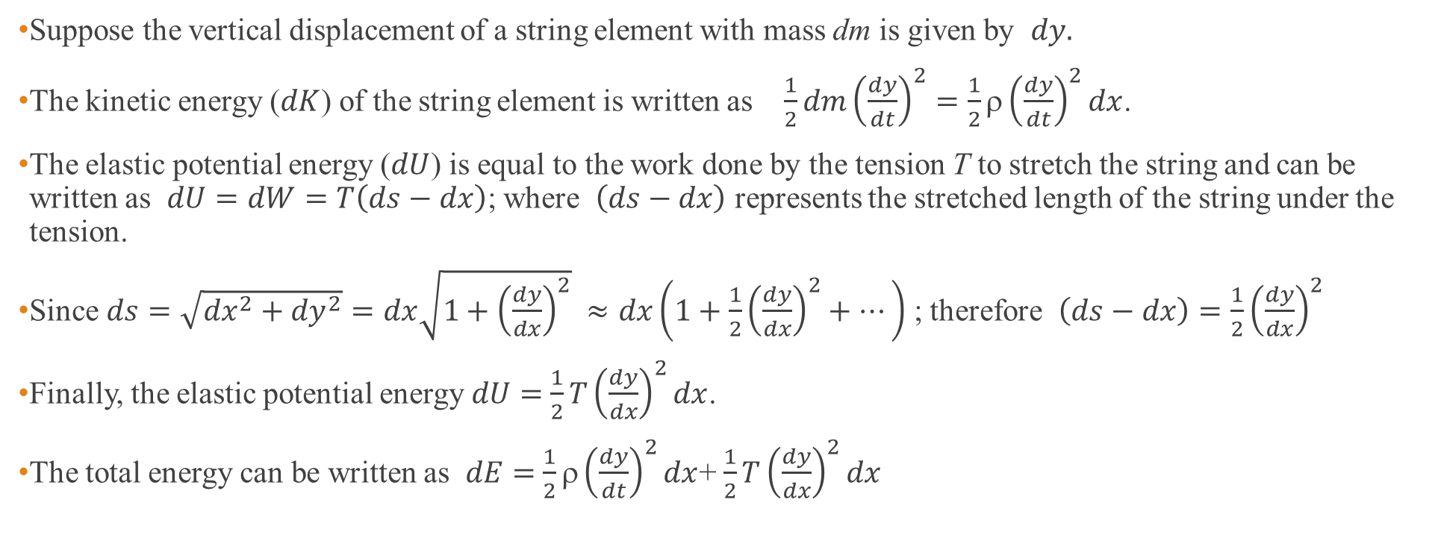
Derive the energy flow of a wave on a string
Suppose the vertical displacement of a string element with mass dm is given by $dy.$
The kinetic energy ($dK$) of the string element is written as $\frac{1}{2}dm{\left(\frac{dy}{dt}\right)}^{2}=\frac{1}{2}ρ{\left(\frac{dy}{dt}\right)}^{2}dx$.
The elastic potential energy ($dU$) is equal to the work done by the tension T to stretch the string and can be written as $dU=dW=T\left(ds−dx\right)$; where $\left(ds−dx\right)$ represents the stretched length of the string under the tension.
Since $ds=\sqrt{{dx}^{2}+{dy}^{2}}=dx\sqrt{1+{\left(\frac{dy}{dx}\right)}^{2}} ≈dx\left(1+\frac{1}{2}{\left(\frac{dy}{dx}\right)}^{2}+⋯\right)$ ; therefore $\left(ds−dx\right)=\frac{1}{2}{\left(\frac{dy}{dx}\right)}^{2}$
Finally, the elastic potential energy $dU=$ $\frac{1}{2}T{\left(\frac{dy}{dx}\right)}^{2}dx$.
The total energy can be written as $dE=$ $\frac{1}{2}ρ{\left(\frac{dy}{dt}\right)}^{2}dx$+ $\frac{1}{2}T{\left(\frac{dy}{dx}\right)}^{2}dx$
before
dx
after
$$ds=\sqrt{{dx}^{2}+{dy}^{2}}$$
dy
dx

Slide 30

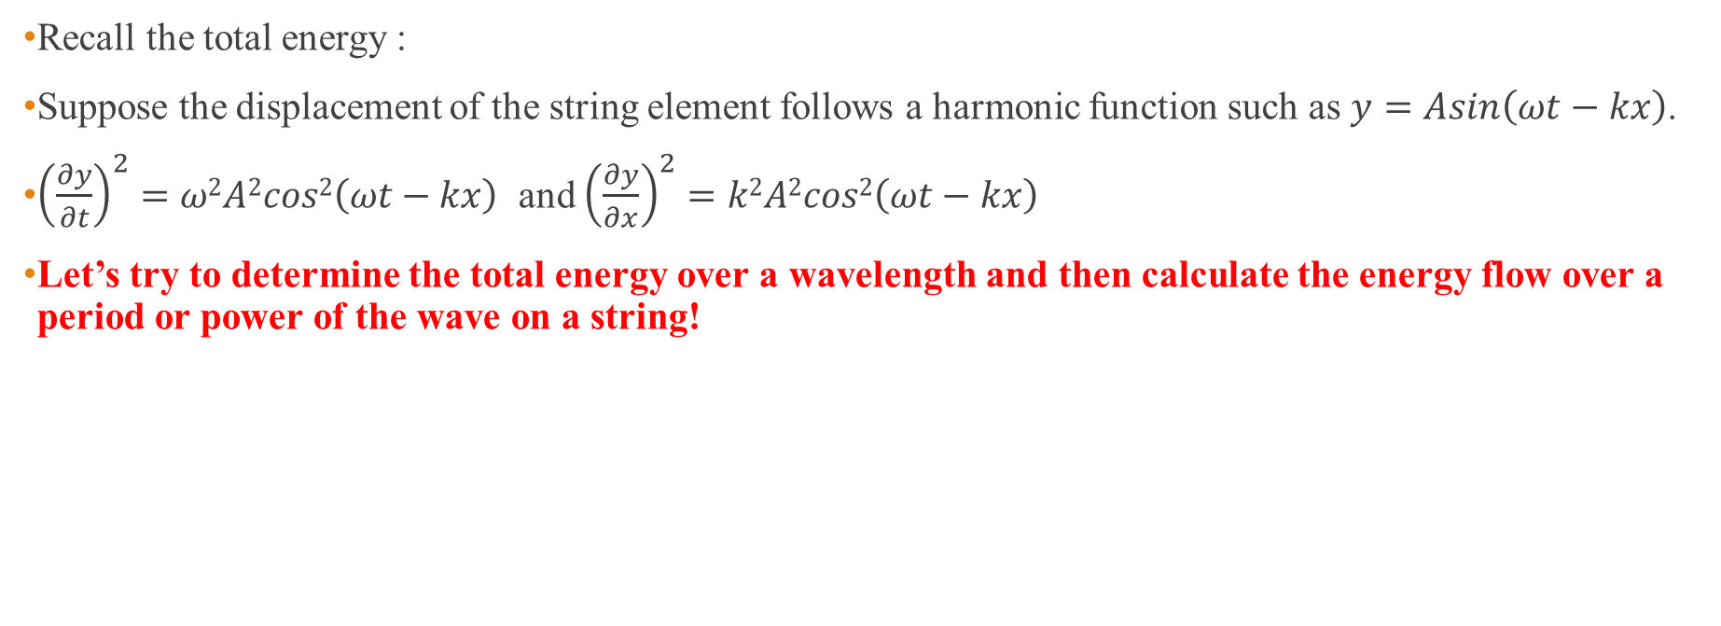
Derive the energy flow of a wave on a string (cont.)
$dE=$ $\frac{1}{2}ρ{\left(\frac{dy}{dt}\right)}^{2}dx$+ $\frac{1}{2}T{\left(\frac{dy}{dx}\right)}^{2}dx$
Recall the total energy :
Suppose the displacement of the string element follows a harmonic function such as $y=Asin\left(ωt−kx\right)$.
${\left(\frac{∂y}{∂t}\right)}^{2}=ω2A2cos2\left(ωt−kx\right)$ and ${\left(\frac{∂y}{∂x}\right)}^{2}=k2A2cos2\left(ωt−kx\right)$
Let’s try to determine the total energy over a wavelength and then calculate the energy flow over a period or power of the wave on a string!

Slide 31
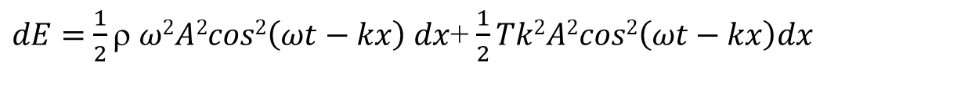
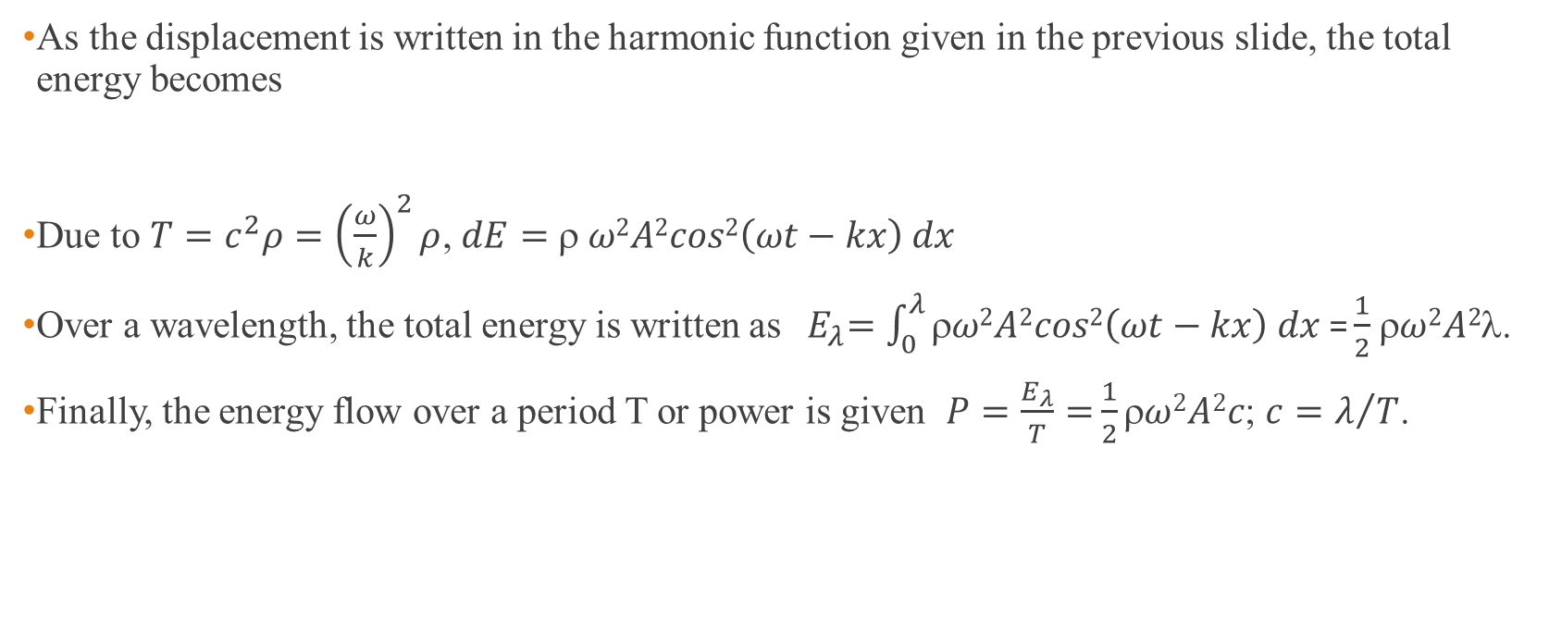
Solution
As the displacement is written in the harmonic function given in the previous slide, the total energy becomes
Due to $T=c^{2}ρ={\left(\frac{ω}{k}\right)}^{2}ρ$, $dE=$ $$ $ω2A2cos2\left(ωt−kx\right) dx$
Over a wavelength, the total energy is written as${ E}_{λ}=\int_{0}^{λ}{ρω2A2cos2\left(ωt−kx\right) dx \text{=}\frac{1}{2}}$ $ω2A2$λ.
Finally, the energy flow over a period T or power is given $P=\frac{E_{λ}}{T}=$ $\frac{1}{2}ρω2A2c$; $c=λ/T$.
$dE=$ $\frac{1}{2}ρ$ $ω2A2cos2\left(ωt−kx\right) dx$+ $\frac{1}{2}Tk2A2cos2\left(ωt−kx\right)dx$

Slide 32
The conservation of energy
All energy arriving at the boundary in the incident wave leaves the boundary in the reflected and transmitted waves.
Note : The proof requires the transformation of B₁ and A₂ to be in terms of A₁.
Notes:
The transformation uses the reflection and transmission coefficients in the calculation.

Slide 33
The reflected and transmitted intensity coefficients
Note : if Z₁ = Z₂ no energy is reflected and the impedances are said to be matched.

Slide 34
Example 3
A transverse harmonic force of peak value 0.3 N and frequency 5 Hz initiates waves of amplitude 0.1 m at one end of a very long string of linear density 0.01 kg/m. Determine the rate of energy transfer along the string and the wave velocity. (ans : 3π/20 W and 30/π m/s)

Slide 35

solution
$$\text{rate} \text{of} \text{energy} \text{transfer}\text{ = }\frac{1}{2}ρcω^{2}A^{2} \\ ∵\text{impedance} \text{Z}\text{ = }\frac{F}{v}=ρc \\ \text{Suppose} y=A\sin\left(ωt−kx\right) \\ v=\dot{y}=ωA\cos\left(ωt−kx\right) \\ ∴z=ρc=\frac{F}{ωA}=\frac{0.3}{\left(2π×5×0.1\right)}=\frac{0.3}{π} \frac{N}{m}⋅s \\ ∴\text{rate} \text{of} \text{energy} \text{transfer}\text{ = }\frac{1}{2}ρcω^{2}A^{2}=\frac{1}{2}\left(\frac{0.3}{π}\right){\left(2π×5\right)}^{2}{\left(0.1\right)}^{2} \\ \text{ =}\frac{3}{20}π \text{W} \\ \text{and} c=\frac{Z}{ρ}=\left(\frac{0.3}{π}\right)\left(\frac{1}{0.01}\right)=\left(\frac{30}{π}\right) \frac{m}{s}$$

Slide 36
The matching of impedances
Impedance matching represents a very important practical problem in the transfer of energy.
The concept of impedance matching is to have the impedance change slowly.
An appropriate length and impedance of another string between two mismatched strings will eliminate energy reflection and match the impedance.

Slide 37
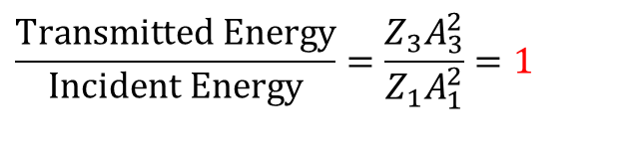

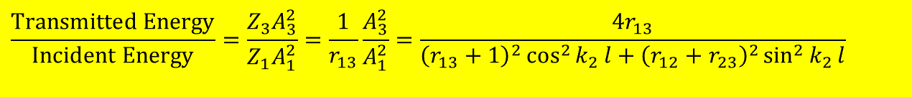
The analysis of the matching impedances
To comply with the condition of matching impedances, the following ratio has to be unity,
To derive the impedance and the length of the inserted piece of the string, the boundary conditions are that y and T(∂y/∂x) are continuous across the junctions x = 0 and x = l.
This gives
Where $r_{12}r_{23}=\frac{Z_{1}}{Z_{2}}\frac{Z_{2}}{Z_{3}}=\frac{Z_{1}}{Z_{3}}=r_{13}$
$$\frac{\text{Transmitted} \text{Energy}}{\text{Incident} \text{Energy}}=\frac{Z_{3}A_{3}^{2}}{Z_{1}A_{1}^{2}}=1$$
$$\frac{\text{Transmitted} \text{Energy}}{\text{Incident} \text{Energy}}=\frac{Z_{3}A_{3}^{2}}{Z_{1}A_{1}^{2}}=\frac{1}{r_{13}}\frac{A_{3}^{2}}{A_{1}^{2}}=\frac{4r_{13}}{{\left(r_{13}+1\right)}^{2}\cos^{2}{k_{2}}l+{\left(r_{12}+r_{23}\right)}^{2}\sin^{2}{k_{2}}l}$$

Slide 38
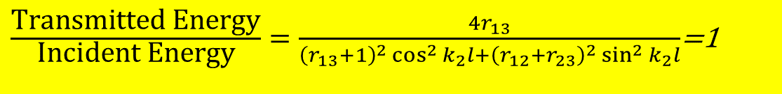
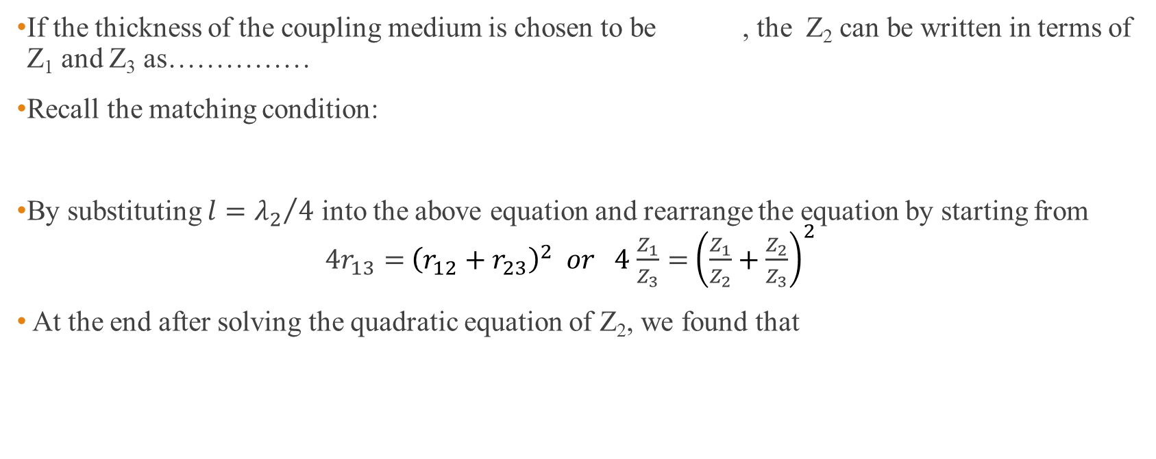
Conditions of impedance matching
If the thickness of the coupling medium is chosen to be , the Z₂ can be written in terms of Z₁ and Z₃ as……………
Recall the matching condition:
By substituting $l={λ_{2}}/4$ into the above equation and rearrange the equation by starting from $4r_{13}=$ ${\left(r_{12}+r_{23}\right)}^{2} or 4$ $\frac{Z_{1}}{Z_{3}}=$ ${\left(\frac{Z_{1}}{Z_{2}}+\frac{Z_{2}}{Z_{3}}\right)}^{2}$
At the end after solving the quadratic equation of Z₂, we found that
$\frac{\text{Transmitted} \text{Energy}}{\text{Incident} \text{Energy}}=\frac{4r_{13}}{{\left(r_{13}+1\right)}^{2}\cos^{2}{k_{2}}l+{\left(r_{12}+r_{23}\right)}^{2}\sin^{2}{k_{2}}l}$=1

Slide 39
Standing waves on a string with fixed ends
The displacement on the string at any point is given by
With the boundary condition that y = 0 at x = 0 and x = l at all times, thus
The complete expression for the displacement of the nth harmonic is given by
This may be expressed as

Slide 40



Derivation of the nth normal mode standing wave function
Recall the superposition of two travelling waves :
By applying the 1st BC : @x = 0, y = 0; $0=ae^{iωt}+be^{iωt}$; $∴b=−a.$
This leads to
By applying the 2nd BC : @ x = l, y = 0; 0 = $ae^{iωt}\left(−2i\sin{kx}\right)$.
This leads to $kl=nπ→l={nλ}/2$. This can be illustrated as
Therefore, a proper form of the nth normal mode standing wave function
can be written as
and simplified to
$$y=ae^{i\left(ωt−kx\right)}+be^{i\left(ωt+kx\right)}$$
$$y=ae^{i\left(ωt−kx\right)}−ae^{i\left(ωt+kx\right)}=ae^{iωt}\left(−2i\sin{kx}\right)$$
$$y_{n}=2a\left(−i\right)\left(\cos{ω_{n}}t+i\sin{ω_{n}}t\right)\sin{\frac{ω_{n}x}{c}}$$
l

Slide 41


Example 4
Show that the total energy of the nth normal mode of a standing wave with a length of l is given
  $$E_{n}=\frac{1}{4}mω_{n}^{2}\left(A_{n}^{2}+B_{n}^{2}\right)$$
Given that the wave function of nth normal is written as
$$y_{n}=\left(A_{n}\cos{ω_{n}}t+B_{n}\sin{ω_{n}}t\right)\sin{\frac{ω_{n}x}{c}}$$

Slide 42
Solution
The energy in each harmonic is composed of kinetic and potential energy.
Where
Notes:
This has to be considered the unit length.

Slide 43
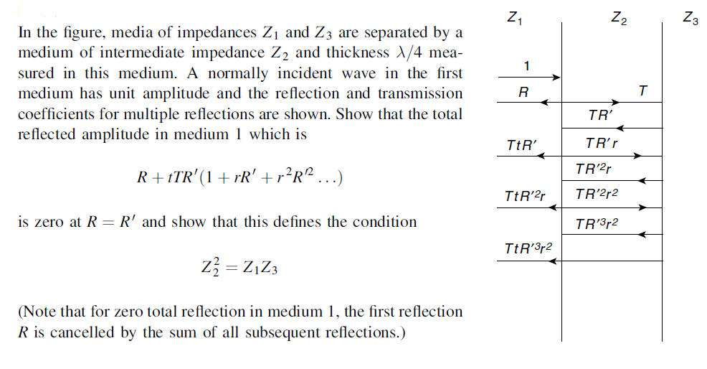
Homework #5
1.

Slide 44
2.

